Slide 1






Acclaim Technology Services India Private Limited was Incorporated in 1984 for the specific purpose of providing Renewable Energy solutions, Technical design and engineering consultancy to chemical and allied industries.
Over the years diversified and has been working in the area of “Green Energy” – Biomass Gasification.
Since the late 90s working on sustainable and renewable energy technologies and actively involved in biomass gasification, Bio methanation (Biogas in association with BARC), Solar PV, Solar Concentrators for thermal applications and Energy audits.
Notes:
Acclaim Technology Services .. Have been in the business of providing Renewable Energy solutions to Industries since 1984 employing various technologies in association with BARC, IISc, to name a few.

Slide 2
- Activated Carbon
Acclaim holds an IPR for a Multistage carboniser designed to convert of all types of solid biomass as well as refuse-derived fuel (RDF) into charcoal. Especially, coconut shell to charcoal, for use in activated carbon manufacture.
Acclaim also holds and IPR for a two-stage in-line manufacture of Activated carbon with total energy recovery .
Acclaim has been working with Activated carbon manufacturers offering techno-commercial solutions

Slide 3
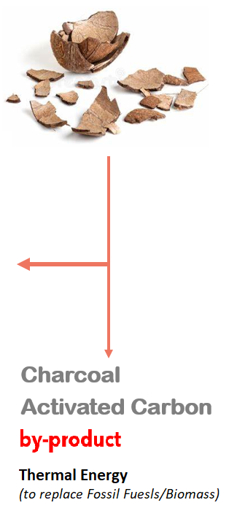
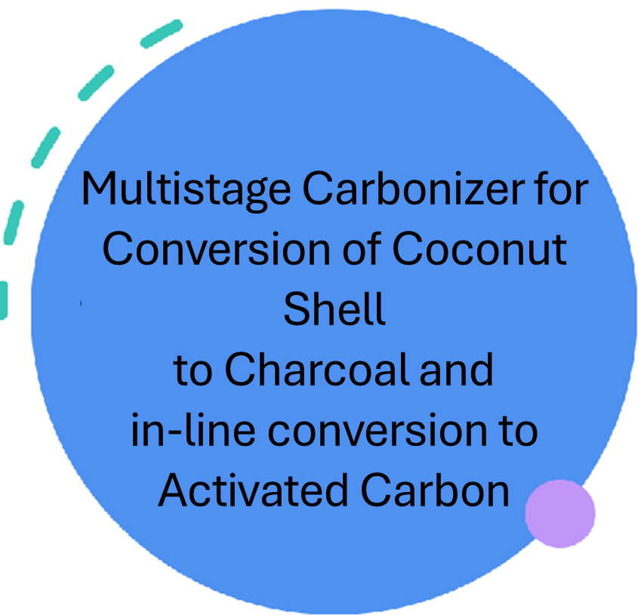

Notes:
This project is for conversion of Coconut Shell to Shell Charcoal or Activated Carbon and Waste heat recovery for Thermal Energy for Heating and/or Power Generation with Zero Pollution

Slide 4



Process
Thermo-chemical process under
controlled stoichiometric conditions yields
  Volatile Gas and
  Charcoal and/or
  Activated Carbon

Slide 5
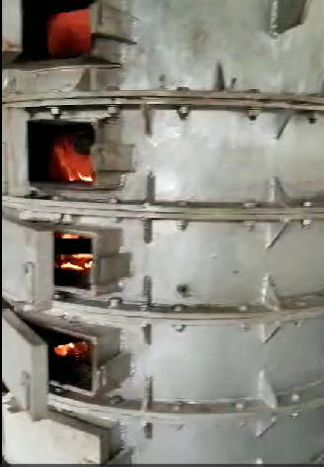

Multi-stage Carbonisation Tech
(material pass through stacked multiple units)
This provides flexibility to control the process at every stage and get required product quality.
Process operating conditions can be modified to produce energy as required.
Notes:
The multi stage gasification technology is the patented technology and made in India. The technology provides flexibility to control the process at every stage and get required product quality. Process operating conditions can be tweeked to produce Charcoal or desired quality or energy as required, which is the highlight of the technology.
.

Slide 6

Benefits of Multi-stage Carbonisation
Unique equipment design integrates both gasification and pyrolytic processes in charcoal making.
Carbonization under gasification and stabilization under pyrolytic conditions.
Can be operated both on energy or charcoal mode.
Can handle multiple biomass inputs and deliver products with
varying specifications.
Can be operated in both up-draft and down draft mode.
Designed for continuous, 24/7 operation.
Designed for thermal efficiency in energy recovery. Insulated, both inside and outside
Notes:
The benefits of Gasification are:

Slide 7
Benefits of Multi-stage Carbonisation
High Energy Efficiency
Easy to Operate
Safe to Operate
(works under Negative Pressure)
Open system type
No Pressure build up
(Explosion proof)
Highly responsive System dynamics
Notes:
The benefits of Gasification are:

Slide 8

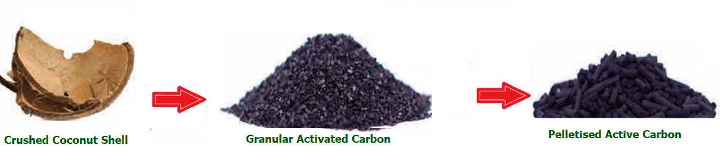
Products
Notes:
Besides the Clean energy recovered which can be used for heating, chilling or Power generation, the process can deliver Shell Charcoal or converted into Activated carbon in-line. Shell charcoal is in great demand for further processing into Activated Carbon or sold for Briquetting/pelleting. Multiple options are available which makes the project very versatile.

Slide 9
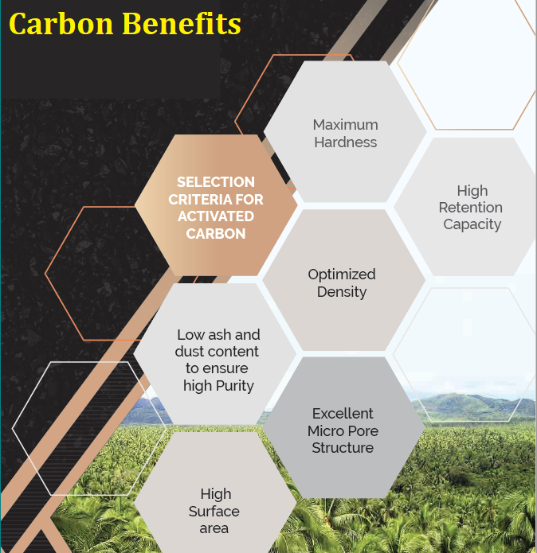
Activated Carbon made from Coconut shell has very high carbon content and the porous surface structure allows it to absorb materials over a large surface area
Notes:
Activated carbon from Shell is in great demand over Wood Charcoal and Bamboo charcoal in various industries mainly for purification of water.

Slide 10


Slide 11
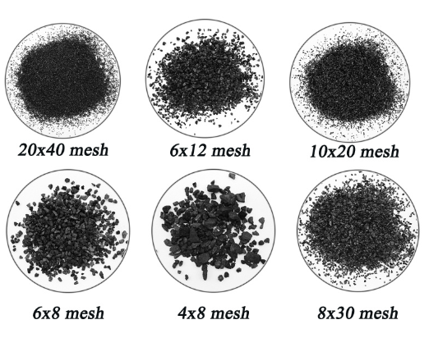
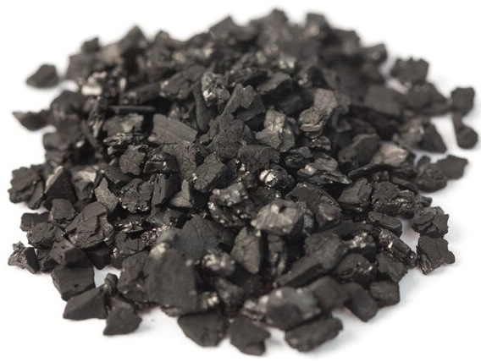
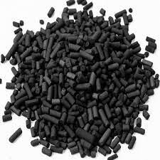
Product Portfolio
Activated Carbon Options
  Acid/Water Washed
  Granular
  Impregnated
  Pellet
  Powdered
Notes:
Activated Carbon too has various adaptions depending on the market being targeted and end use to which it is put to. The options are discussed elsewhere in this presentation.

Slide 12
Product Portfolio- Regular

Slide 13
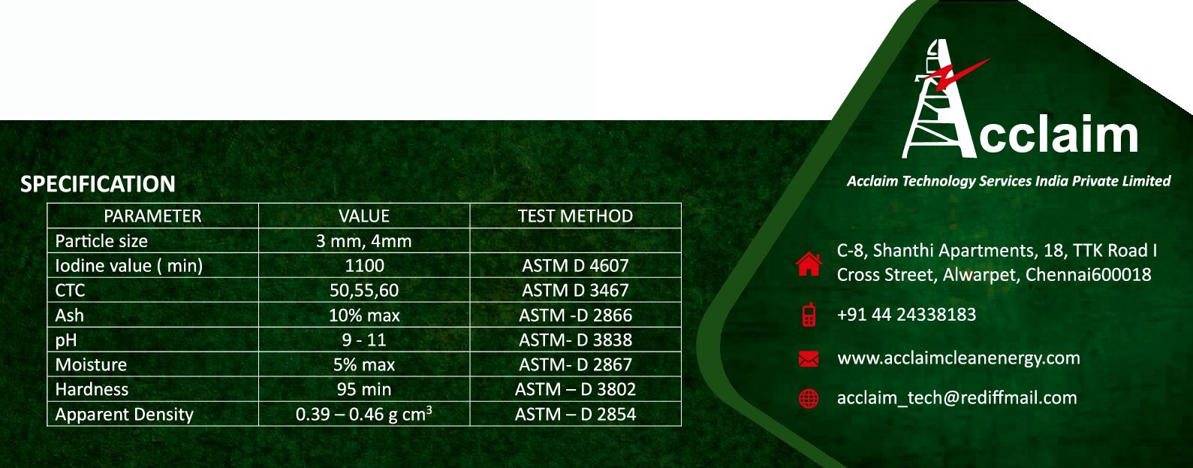
Product Portfolio- Pellet

Slide 14
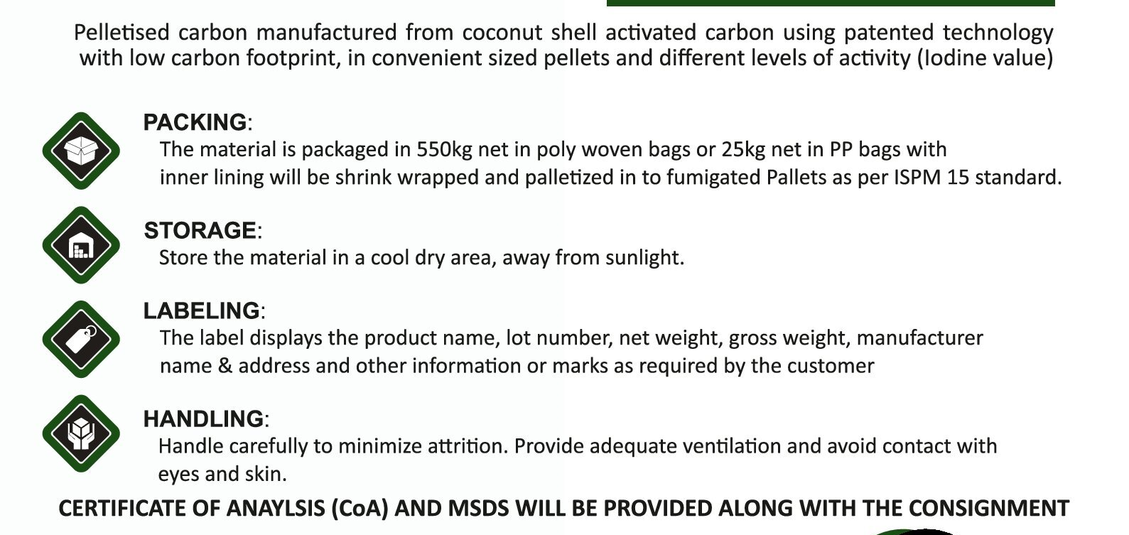
Product Portfolio- Packing and supply

Slide 15



Thank you
Contacts
V C Mohan -+919444019321,vcmohan@gmail.com
K S Narayanan
+1……………
Ashok Ganapathy
+1
Acclaim Technology Services
India Private Limited
(In Renewable Energy since 1984)
C-8, Shanthi Apartments
18 (Old 21), TTK Road 1st Cross
Alwarpet, Chennai.600018 INDIA

